Slide 1







Loan Application General Process Flow Ver. 1
Applicant
Comaker
Processor
Accountant
Credit Officer
Audit Officer
Approver
Start
Approved/ Disapproved
Update Members Monthly Details
File Loan Application
Periodically Update profile
Agree ?
Y
Approved/ Return Application
Both Approved ?
N
N
Update Details
A
Update Details
Print/ Upload Form
Update Status / For Submission
B
Approved/Return Application
Y
B
Submit Application
Approved ?
Approved/ Return Application
Y
A
N
End
File Application
Cancel Application
A

Slide 2
Loan Application General Process Flow Ver. 2
Applicant
Comaker
Processor
Accountant
Credit Officer
Audit Officer
Approver
Start
Approved/ Disapproved
Update Members Monthly Details
Create/Submit Loan Application
check Details
check Comaker Status
Agree ?
Y
Periodically Update profile
N
Update Details
Update Details Approve/ Dis
Approve/ Disapprove
A
Print/ Upload Form
Update Status / For Submission – record monthly Amortization
File/Submit Application
Y
Approved ?
A
N
End
File Application
Cancel Application
A

Slide 3
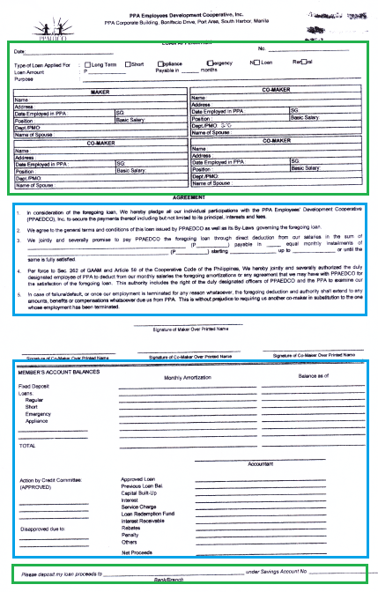
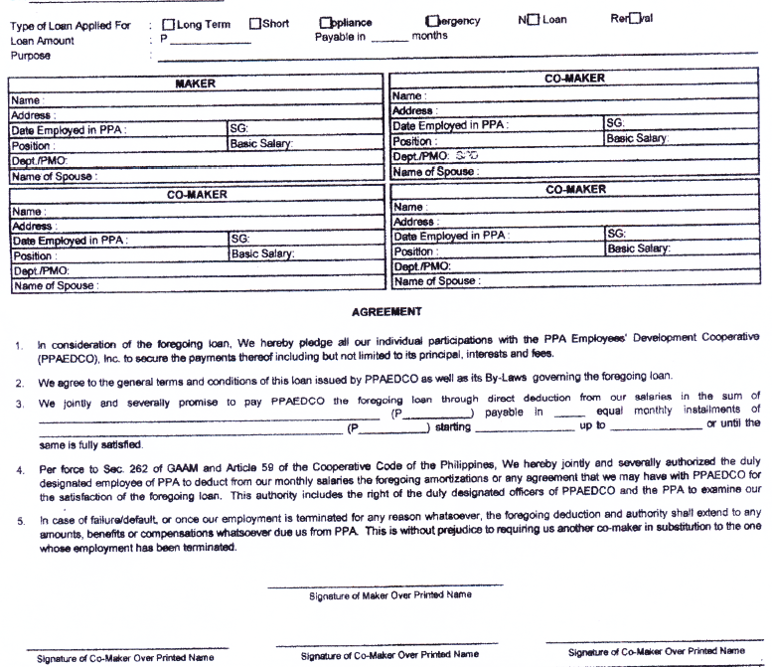
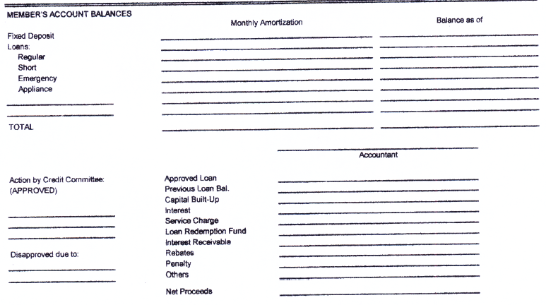
Loan Application General Process Flow
Application Form
FILING
DETAILS

